Slide 1

LET’S PLAY JEOPARDY!!

Slide 2
Teams!
Plakmeyer
  A Team
  B Team
  C Team

Slide 3
Jeopardy Rules
Write answer on the board in the allotted time.

Slide 4
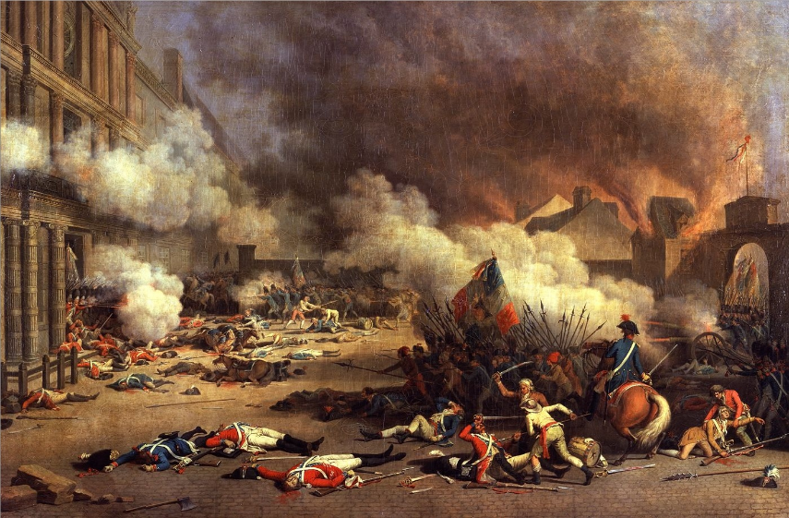

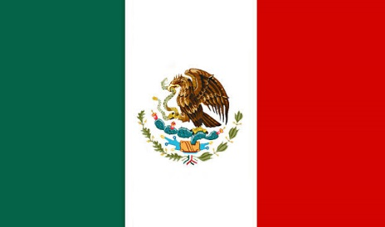
Political Revolutions
Enlightenment Thinkers
French Revolution
Mexican Revolution
Mughal Empire
Religion of Islam
Leaders & Facts
10
10
10
10
10
10
20
20
20
20
20
20
30
30
30
30
30
30
40
40
40
40
40
40
50
50
50
50
50
50
Final Jeopardy

Slide 5
10pt Answer from Category 1
    The philosopher who believed that natural rights were as follows: “life, liberty, and property.”

Slide 6
10pt Question from Category 1
Who is John Locke?

Slide 7
20pt Answer from Category 1
    This Enlightenment philosopher believed the world would be chaos without an absolute monarch who could be the enforcer of rules and fairness.

Slide 8
20pt Question from Category 1
Who is Thomas Hobbes?

Slide 9
30pt Answer from Category 3
    An agreement between the people and their government is called:

Slide 10
30pt Question from Category 1
What is a social contract?

Slide 11
40pt Answer from Category 1
    This Enlightenment philosopher asserted that rulers should be elected by the people and make rules based on the principal of the common good.

Slide 12
40pt Question from Category 1
Who is Jean-Jacques Rousseau?

Slide 13
50pt Answer from Category 1
    He wrote about the ills of society, such as slavery, in order to change society. He was exiled out of France and his published work was banned.

Slide 14
50pt Answer from Category 1
Who is Voltaire?

Slide 15
10pt Answer from Category 2
    The last monarchs of France were:

Slide 16
10pt Question from
Category 2
    Who is King Louis XVI and Marie Antionette?

Slide 17
20pt Answer from Category 2
This estate number had aristocrats, nobles, and lords.

Slide 18
20pt Question from Category 2
What is the 2nd Estate?

Slide 19
30pt Answer from Category 2
    The legislative branch of France’s old order was called:

Slide 20
30pt Question from Category 2
What is the Estates-General?

Slide 21
40pt Answer from
Category 2
    The National Assembly’s promise to keep meeting until they had a French constitution was called:

Slide 22
40pt Question from Category 2
What is the Tennis Court Oath?

Slide 23
50pt Answer from Category 2
He was an extreme leader of the French Revolutionary government as he ordered thousands of people to die at the hands of the national razor in era called Reign of Terror.

Slide 24
50pt Question from
Category 2
Who is Maximillien Robespierre?

Slide 25
10pt Answer from Category 3
    These are the two names of the Mexican Revolutionary leaders who were former clergy.

Slide 26
10pt Question from Category 3
Who are Miguel Hidalgo and Jose Morelos?

Slide 27
20pt Answer from Category 3
    This social class was second highest in colonial Latin American society.

Slide 28
20pt Question from Category 3
Who are the creoles?

Slide 29
30pt Answer from Category 3
    A mixture between Indian and white was called:

Slide 30
30pt Question from Category 3
Who are mestizos?

Slide 31
40pt Answer from Category 3
    The third highest class in colonial Latin America was called:

Slide 32
40pt Question from Category 3
Who are the mestizos?

Slide 33
50pt Answer from Category 3
This French emperor installed his brother Joseph Bonaparte as king of Spain and led to increase demands for Latinos to have independence.

Slide 34
50pt Question from Category 3
Who is Napoleon Bonaparte?

Slide 35
10pt Answer from Category 4
    This is the great leader of the Mughals.

Slide 36
10pt Question from Category 4
Who is Akbar the Great?

Slide 37
20pt Answer from Category 4
    This religion believes in 300 million gods.

Slide 38
20pt Question from Category 4
Who are the Hindus?

Slide 39
30pt Answer from Category 4
    The policy of tolerance means…

Slide 40
30pt Question from Category 4
To allow others to practice their own religion

Slide 41
40pt Answer from Category 4
    This Hindu system puts people into certain classes of people. The name of the system is…

Slide 42
40pt Question from Category 4
What is the caste system?

Slide 43
50pt Answer from Category 4
    The blending of Islamic and Hindu religions is called…

Slide 44
50pt Question from Category 4
What is Sikhism?

Slide 45
10pt Answer from Category 5
He was the last prophet of Islam.

Slide 46
10pt Question from Category 5
Who is the Prophet Muhmmad?

Slide 47
20pt Answer from Category 5
This is the Arabic name for God.

Slide 48
20pt Question from Category 5
Who is Allah?

Slide 49
30pt Answer from Category 5
    One of the Pillars of Islam is to make a trip to this holy city.

Slide 50
30pt Question from Category 5
What is Mecca?

Slide 51
40pt Answer from Category 5
    He became the first successor to the Prophet Muhummad.

Slide 52
40pt Question from Category 5
Who is Abu Bakr?

Slide 53
50pt Answer from Category 5
This is the name for Islamic law.

Slide 54
50pt Question from Category 5
What is Sharia?

Slide 55
10pt Answer from Category 6
He is considered the founder of Christianity.

Slide 56
10pt Question from Category 6
Who is Jesus of Nazareth?

Slide 57
20pt Answer from Category 6
He is considered the founder of Islam.

Slide 58
20pt Question from Category 6
Who is Prophet Muhammad?

Slide 59
30pt Answer from Category 6
Jews and Muslims both abstain [do not] from eating ______.

Slide 60
30pt Question from Category 6
What are pigs (pork)?

Slide 61
40pt Answer from Category 6
This empire expanded in the Middle East, causing the Europeans to lose their trade route access to spices and silk of the Far East. As a result, Europeans began to look for a sea route to Asia to avoid this empire.

Slide 62
40pt Question from Category 6
What is the Ottoman Empire?

Slide 63
50pt Answer from Category 6
This continent began to dominate trade and resources from the 1500’s to the 1900’s.

Slide 64
50pt Question from Category 6
What is Europe?

Slide 65
Final Jeopardy Topic
    Eighth and Ninth Grade History Classes

Slide 66
Final Jeopardy Answer
Both the Mexican and French Revolutions were inspired by this revolution in North America. What’s the name of the revolution?

Slide 67
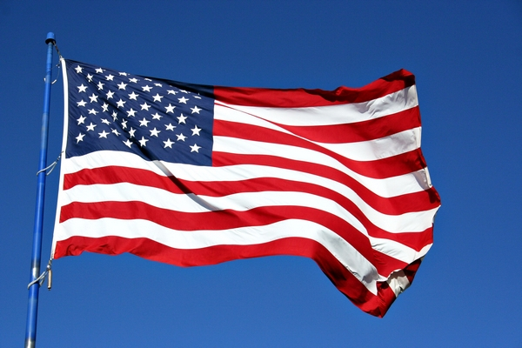
Final Jeopardy Question
    What is the American Revolution?

